Slide 1
Promoting Environmental Justice as an Essential Best Management Practice for Utilities in Economically Distressed Communities
Andrew Kricun, P.E.
Deputy Executive Director / Chief Engineer
Camden County Municipal Utilities Authority
Camden, New Jersey
September 15, 2011

Slide 2
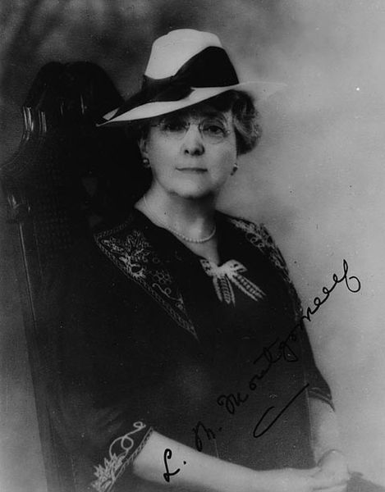
“It isn’t what the world holds out for you… but what you bring to it!”
L.M. Montgomery

Slide 3
Wastewater Managers Have A Tremendous Challenge…
And Opportunity, To Improve Things!

Slide 4
Wastewater Managers can Make a Positive Difference By:
Optimizing Water Quality
Minimizing Odors
Achieving Cost Efficiencies to Reduce Rates
Reducing Carbon Footprint, and Other Green Initiatives

Slide 5
These challenges, and opportunities, are especially prevalent for wastewater utilities operating in economically distressed communities…like Camden City, NJ

Slide 6
Camden City, NJ
One of the poorest cities in the nation
One of the highest rates of violent crime in the nation
Poor urban planning (little separation between residential community and industry)
Aging infrastructure (sewer system is over 100 years old)
Notes:
The EMS is integrated across all organizations. Therefore, having order and consistency of methodologies is important for looking at work activities and processes. With a set of integrated information, allocation of resources and evaluation of effects of processes can be done on a continual basis. Process mapping is a tool that provides a visual look at work as it occurs. Supply chain is a term that has been used for each contributor in a process. Minimizing impacts to the environment early in the process, improves the overall efficiency of that process. Looking at waste at the end of a process and asking how that waste could be prevented is an example of this. Ask the participants for some examples. Examples of recycling bottles may be used. Point out the specific example of recycling Corona beer bottles from the ship.

Slide 7
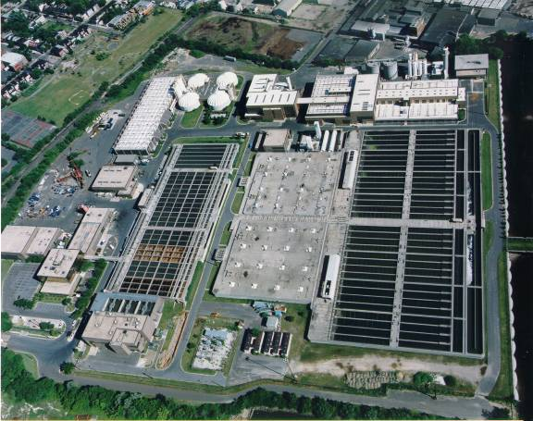
Camden County Municipal Utilities Authority (CCMUA)
Services 500,000 customers in Southern New Jersey
Design Flow: 80 MGD
Average Flow: 58 MGD
Secondary, pure oxygen activated sludge treatment
Discharges to Delaware River

Slide 8
Initial Conditions
CCMUA obliged to raise rates by 22½%, from $275 per household to $337
Numerous odor complaints from neighboring residents
Plant struggling to meet state discharge limits, despite receiving only 70% of rated capacity

Slide 9
Initial Conditions (cont.)
Odor problems lead to:
Adversarial relationship with community – Lawsuit filed
Adversarial relationship with regulators - $8 million fine

Slide 10
Turning Point Needed – Possible Solutions
Privatization
Internal Improvements
Ultimately, Camden County decided to strive for internal improvements

Slide 11
Goals
CCMUA has three fundamental goals that are critical to its success:
Optimization of Water Quality Performance
Optimization of Air Quality Performance
Cost Minimization

Slide 12
Environmental Management Systems
Help an organization identify its environmental performance goals
Harness and direct the organization’s collective wherewithal toward meeting performance goals
Establish permanent, sustained drive toward continual improvement
Notes:
The EMS is integrated across all organizations. Therefore, having order and consistency of methodologies is important for looking at work activities and processes. With a set of integrated information, allocation of resources and evaluation of effects of processes can be done on a continual basis. Process mapping is a tool that provides a visual look at work as it occurs. Supply chain is a term that has been used for each contributor in a process. Minimizing impacts to the environment early in the process, improves the overall efficiency of that process. Looking at waste at the end of a process and asking how that waste could be prevented is an example of this. Ask the participants for some examples. Examples of recycling bottles may be used. Point out the specific example of recycling Corona beer bottles from the ship.

Slide 13
Implementation of EMS
Identification of Core Corporate Objectives
Optimization of Water Quality Performance
Optimization of Odor Control Performance
Cost Minimization
Identification of Core Goals assures sufficient allocation of necessary resources

Slide 14
Gap Analysis
Identify each critical process and…
Identify the gaps between current performance levels and desired levels

Slide 15
Team Chartering & Awareness Training
EMS Team composed of top management, ensuring corporate buy-in at highest levels of organization
High level EMS champion an absolute necessity
Core Corporate Goals Communicated from top management down to line workers
Specific technical experience communicated from line workers back up to top management to ensure capture of all potential improvement opportunities

Slide 16
Odor Prevention Change Institutional Culture
Closed odorous sludge composting facilities
Odor inventory by independent consultant
Installed new odor control systems at plant headworks
Imposed zero tolerance policy with respect to odors from carelessness (doors left open; odor systems left off, etc)
Increased supervision, especially on weekends
Numerous outreach attempts to neighboring community to improve relationship

Slide 17
Water Quality Seek “Supercompliance”
Decided that merely meeting permit was unacceptable; effluent quality should be optimized
Required that all systems must be maintained and available for service
Installed new sludge thickening and dewatering facilities to improve plant’s sludge removal capability
Plant bypasses no longer permitted without express NJDEP approval

Slide 18
Environmental Management Systems – Environmental Benefits
Effluent Quality Improved by 40-50%
22ppm TSS in 1999 to 8ppm in 2008
25ppm BOD in 1999 to 5ppm in 2008
Sludge Removed Improved by 45%
11,000 dry tons removed in 1999 to 16,000 dry tons in 2008
Odor Violations down from 16 in 1997/98 to 4 from April 1998 to December 2008

Slide 19
Happy Ending … or a New Beginning
Odor prevention established as a core priority
No longer the “ceiling” goal, but the new “floor”
CCMUA now looked for other opportunities to help the community

Slide 20
Environmental Justice Initiatives
Reduced rates for Camden City residents
Elimination of truck traffic
Creation of a waterfront park
Creation of a Community tree nursery

Slide 21
Environmental Justice Initiatives (Cont.)
Flooding reduction initiatives
Combined sewer overflow system improvements
Federal Grant Assistance to the City
Provision of Technical Assistance to the Community

Slide 22
Improved Relations with Community & Regulators
CCMUA and Community groups now civic partners
Joint recipients of USEPA Grant for diesel reductions
Joint recipients of USEPA CARE Grant
CCMUA recognized by USEPA and NJDEP for improved performance

Slide 23
Doing the Right Thing is also the Smart Thing
Improved relations with community & regulatory agencies results in reduced risk to agency
Reduced risk of fines, lawsuits
Reduced risk of bad public relations

Slide 24
The ”Cost” of Environmental Justice
Did improved environmental performance result in cost increases or rate increases?
NO!
Team managers were directed not to choose between performance improvements and cost savings, but rather to look for initiatives that would both improve performance and reduce costs
Other Environmental Justice initiatives were generally low cost/high impact

Slide 25
Economic Benefits
Reduced O&M Costs by 25% within three years
Annual Savings of $5,000,000 per year
$50,000,000 saved since 1999
No rate increases since 1996, with three rate cuts
Achieving efficiencies in operations resulted in improved environmental performance and cost savings.

Slide 26
Next Steps
Odor Control Initiatives
New sludge drying facility
Upgraded odor control systems
Community Outreach Initiatives
Public Safety
Green Space

Slide 27
EMS Benefits Available to All
EMS resulted in improved efficiency which led to both improvement in environmental performance and significant cost savings as well
CCMUA achieved significant improvements through EMS even though:
It was an average, borderline compliant, utility prior to EMS
Camden City is the poorest city in the nation

Slide 28
Conclusion
Wastewater Managers have an opportunity to make a big positive difference
Water quality
Odor minimization
Community service
“With great power comes great responsibility”

Slide 29
Thanks for Listening!
If you would like more information, please contact:
Andrew Kricun, P.E.
Deputy Executive Director / Chief Engineer
Camden County Municipal Utilities Authority
Camden, New Jersey
856-583-1223
andy@ccmua.org

